Slide 1

Advanced Programming Practices (SOEN 6441)
Project Build 3 – Team 19
Meetkumar Kalariya | 40293692
Nen Patel | 40291812
Rushin Makwana | 40221949
Tushar Jain | 40274220
Amal Gupta | 40293339

Slide 2




Tools and Libraries used for the project
IntelliJ IDE
JDK 21 and Junit 5
GitHub for Version Control and Progress Board
GitHub Actions for CI/CD workflow

Slide 3
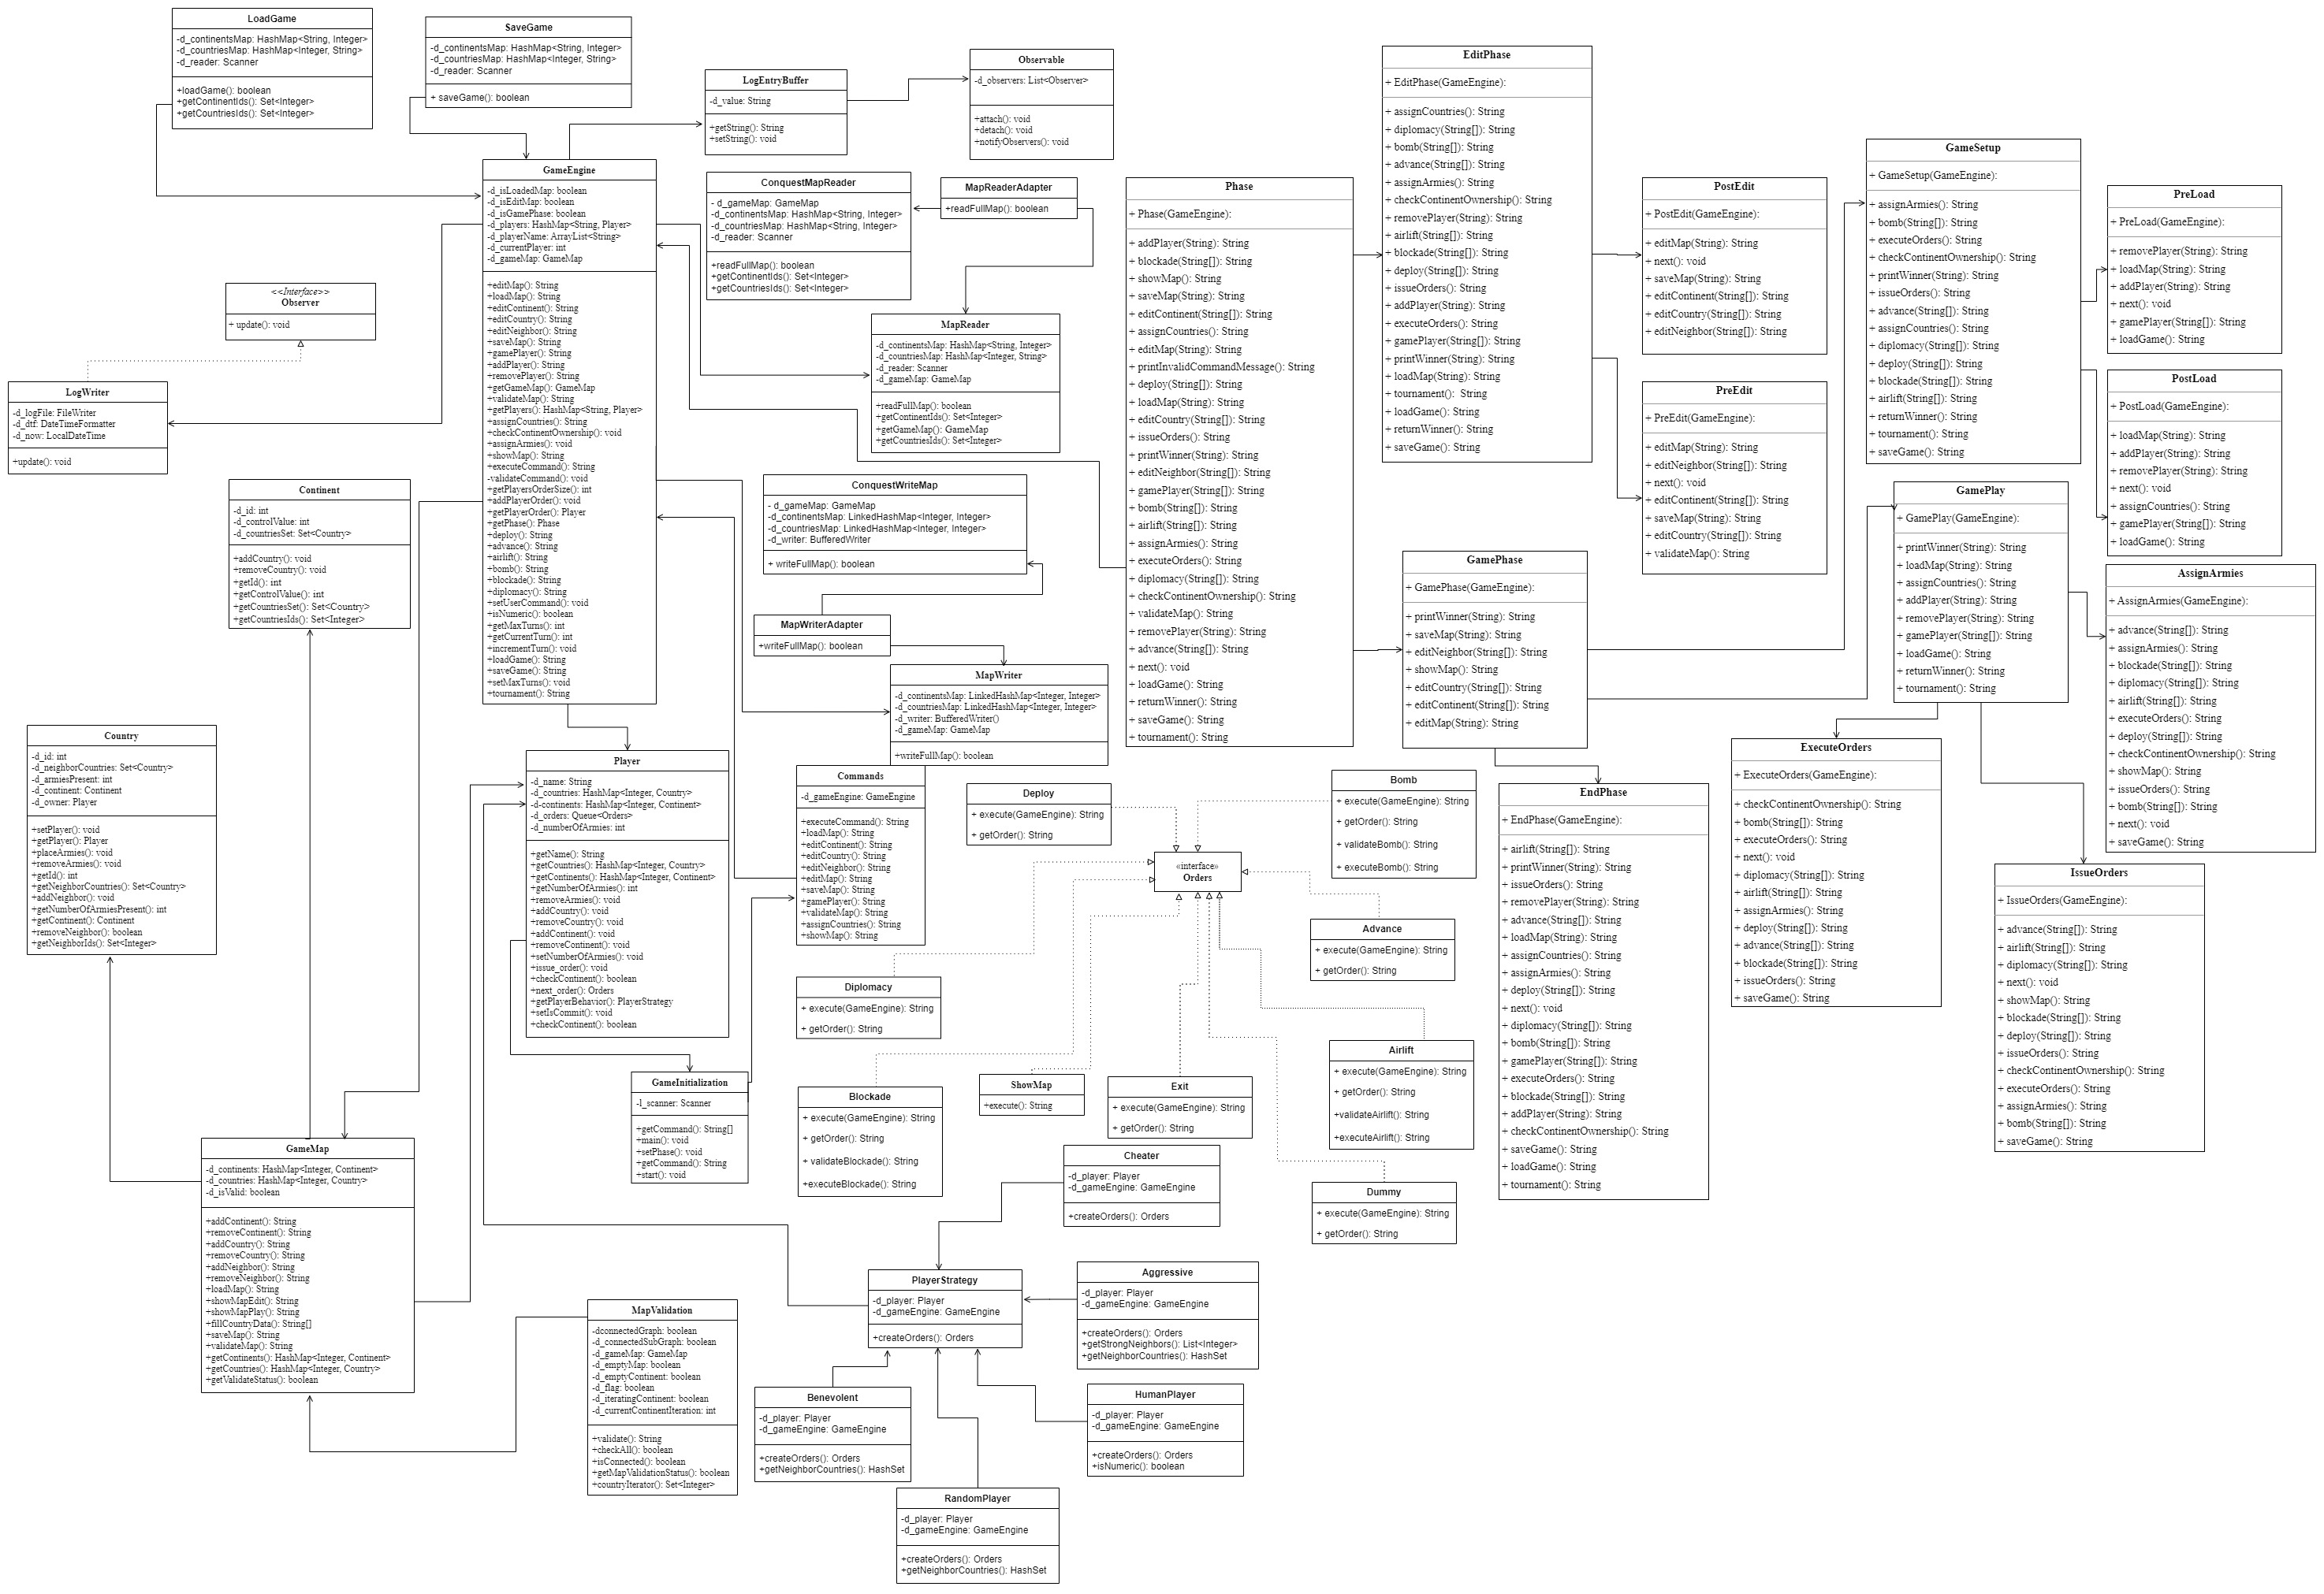
Architectural Design Diagram
Notes:
First up we have the Architectural diagram for our software.

Slide 4
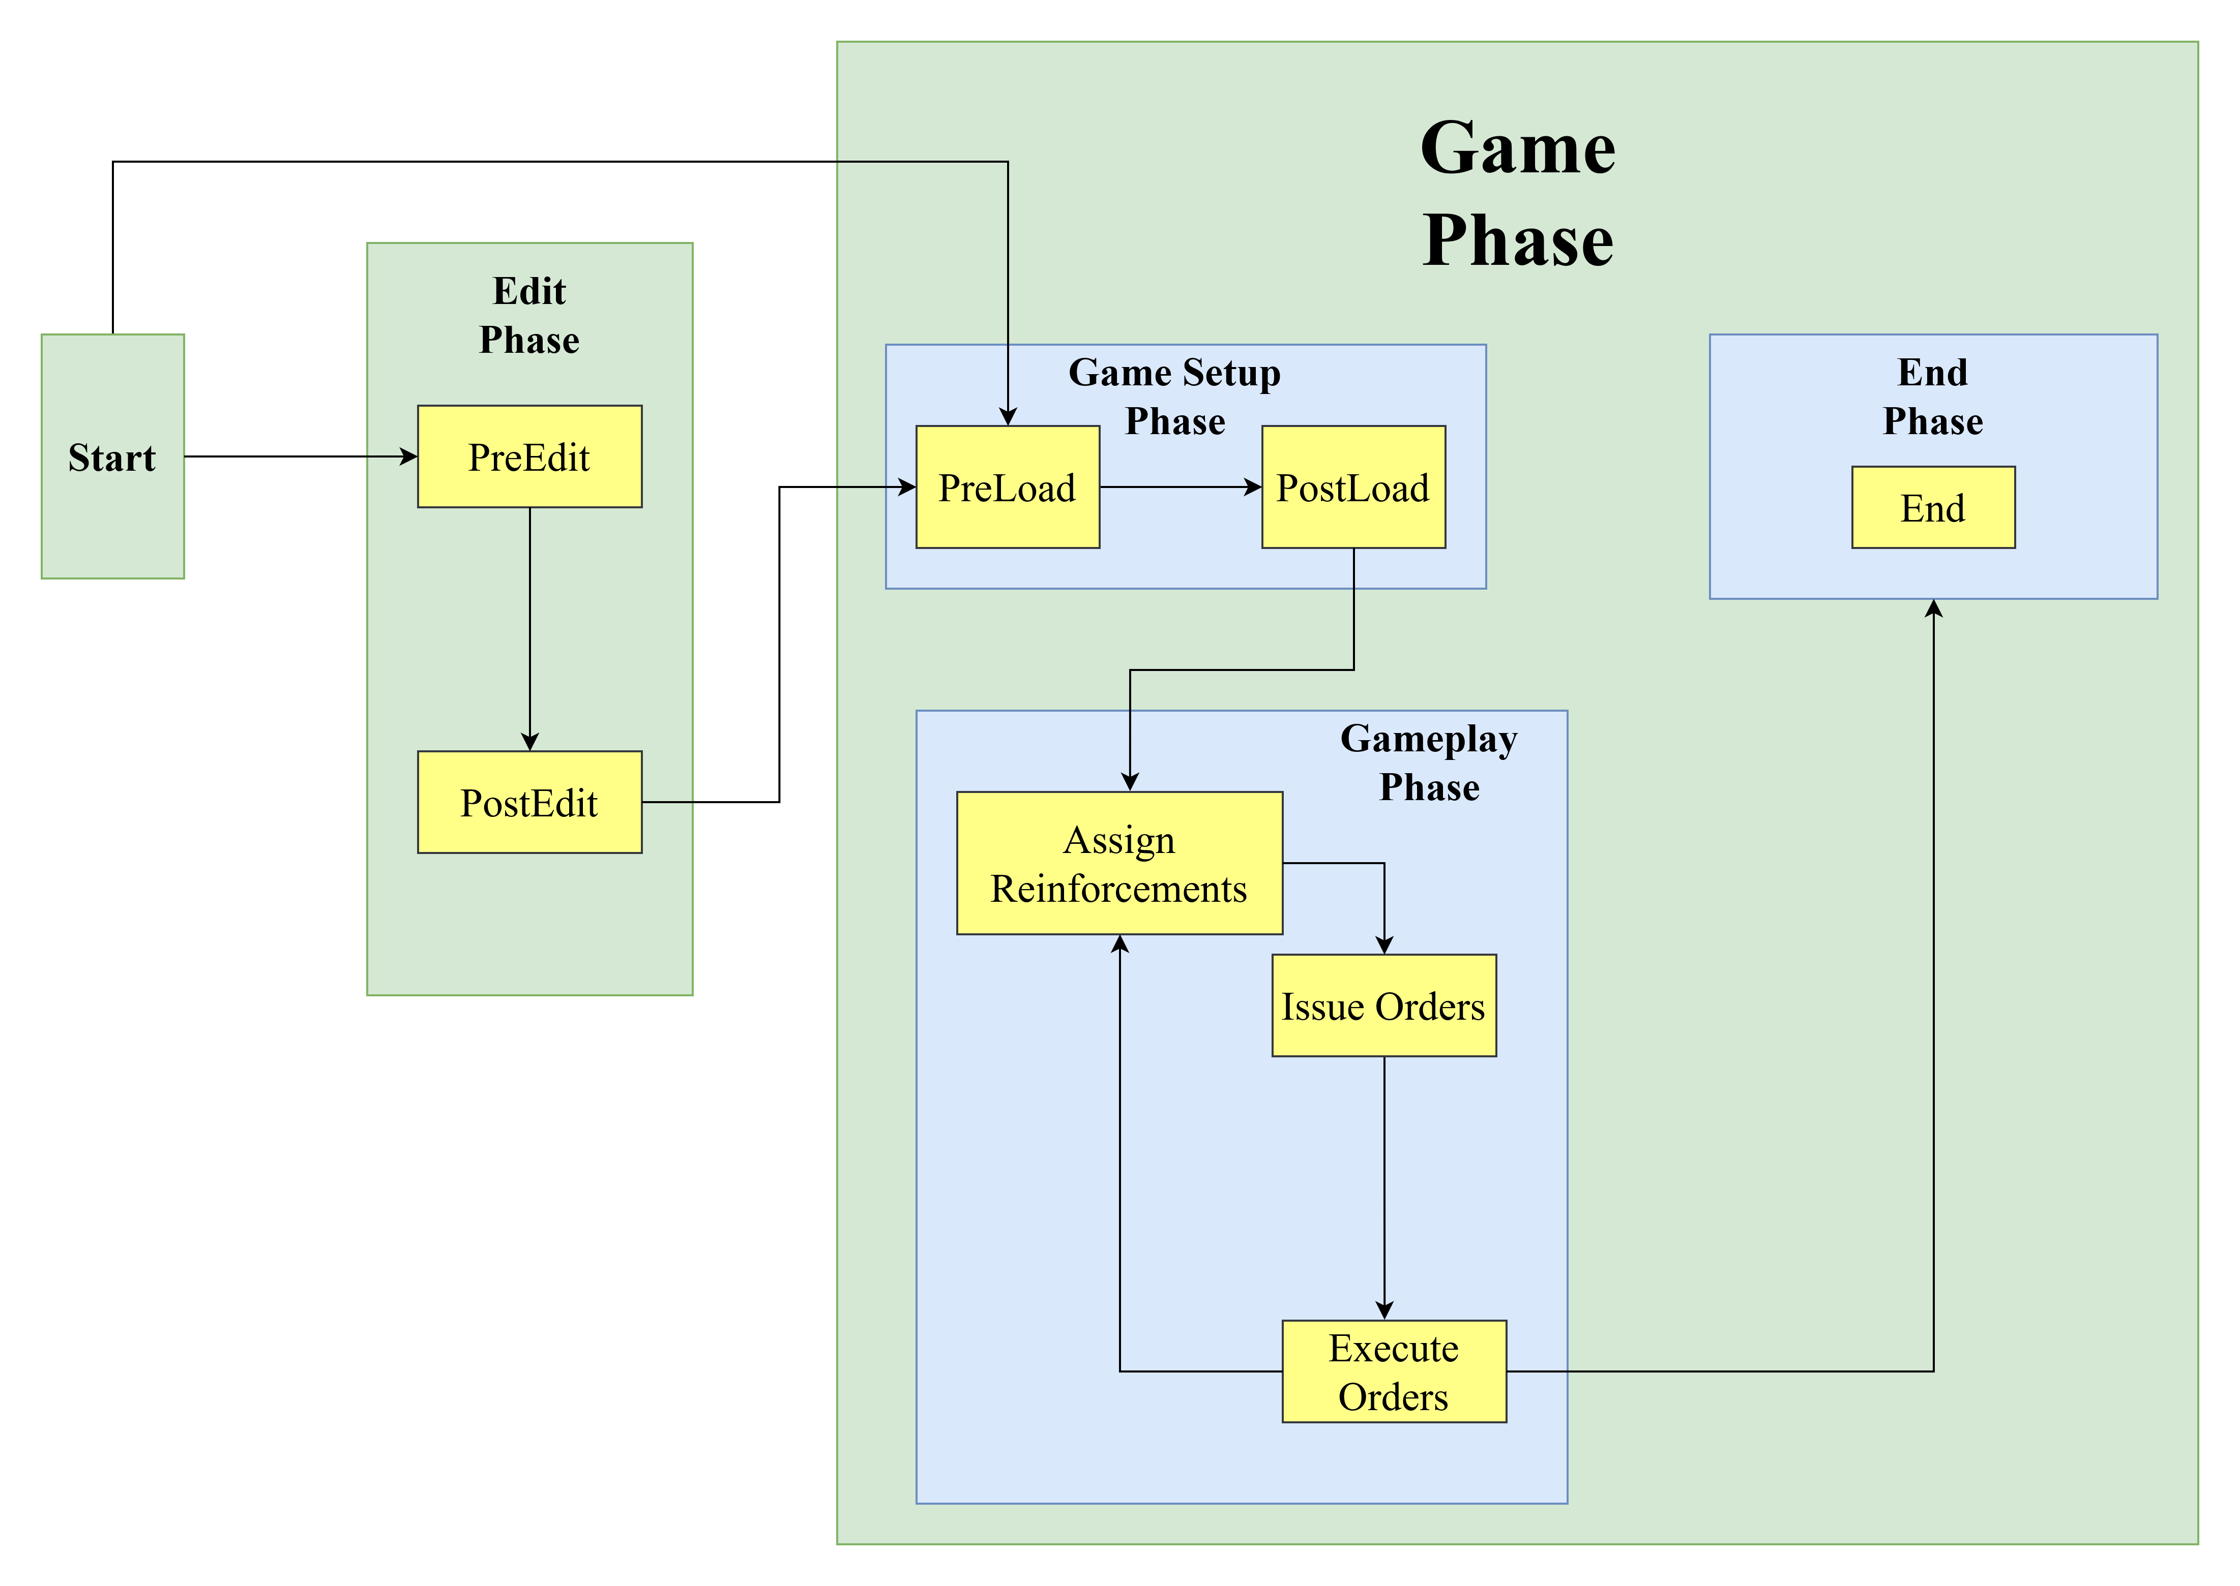
Architecture of State Pattern

Slide 5
Refactoring
Notes:
Let me give a brief introduction for our class.

Slide 6
Refactoring targets
Adapter Pattern – used to enable the application to read or write from or to a file using the “conquest” game map format. The application decides whether to use the “domination” file reader or the “conquest” file reader, when a file is opened, depending on the file type.
When the map file is saved, the user is given the option to decide the file format to use as output.

Slide 7
Refactoring targets
Strategy Pattern –
The player issueOrder method’s behavior is altered by using the Strategy pattern.
The strategy provide different behaviors that support the Player class to execute varying behavior when executing the issueOrders method.
Player Types are –
Human player
Aggressive player
Benevolent player
Random player
Cheater player

Slide 8
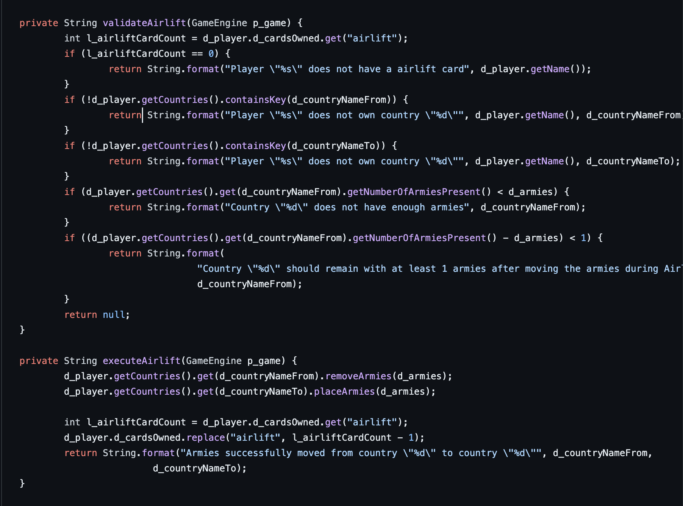
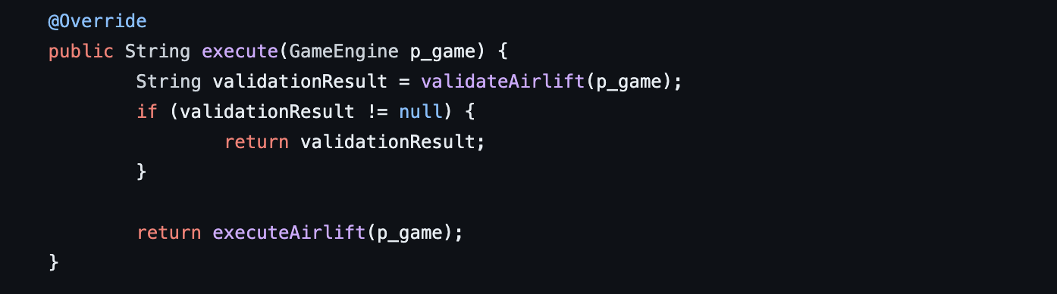
Refactoring targets
3) Updated execute method: The executed method was used to perform many operations within the single method. We have split the execute method into smaller code and in different methods, splitting the code for Airlift, Bomb and Blockade.

Slide 9
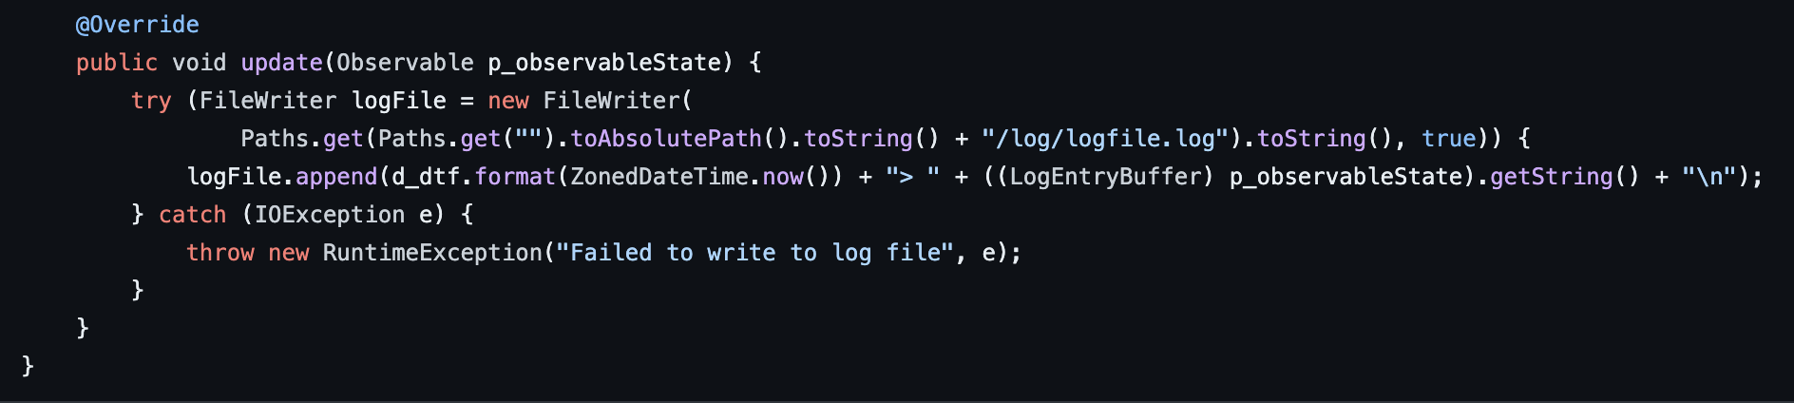
Refactoring targets
4) Improved LogWriter class: The instances variables d_logFile, d_dtf, and d_now are currently package private. It can be made private to adhere to the principle of execution. The FileWriter can be closed in finally block or using try-with-resources, which could lead to resource leaks. The IOException is being caught and printed, but not rethrown or wrapped in a runtime exception.

Slide 10
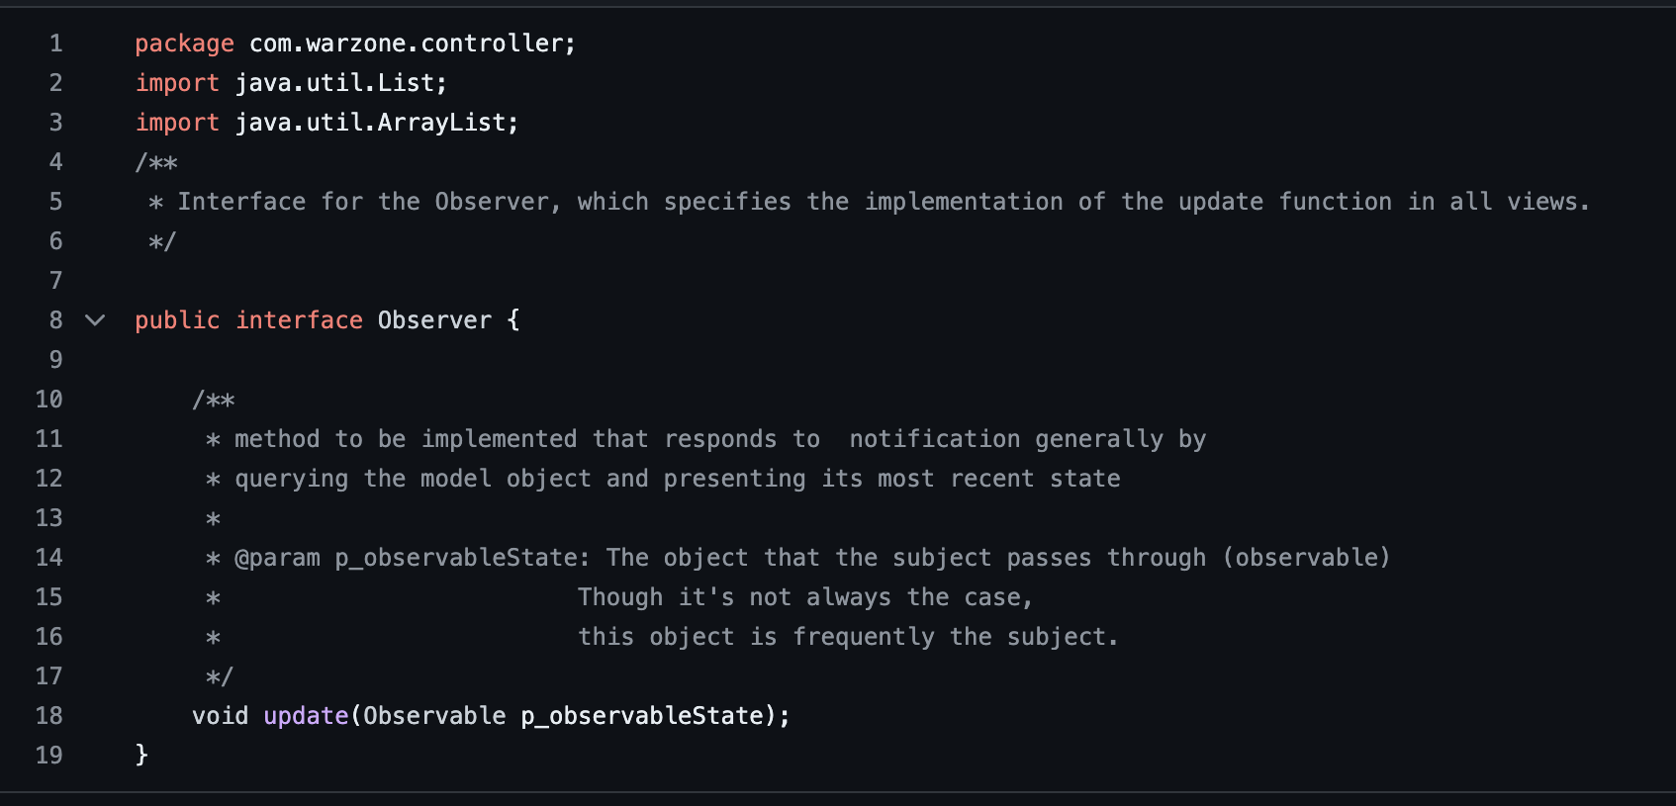
Refactoring targets
Removal of Modifiers from Interface properties –
Remove the public modifiers from method declarations and public static final modifiers from field declarations in interfaces.
Removes the clutter and unifies the attributes of Java interfaces.

Slide 11
Java Class Brief Introduction
Notes:
Let me give a brief introduction for our class.

Slide 12
ConquestMapReader.java
This class is used to read map file.
The application decides whether to use the “domination” file reader or the “conquest” file reader, when a file is opened, depending on the file type.

Slide 13
ConquestWriteMap.java
This class is used to write into map file.
The application decides whether to use the “domination” file writer or the “conquest” file writer, when a file is opened to write, depending on the file type.

Slide 14
MapReaderAdapter.java
This class extends MapReader class.
It provides its implementation for reading a map using Adapter Pattern.
Notes:
Map ops and player ops commands

Slide 15
MapWriterAdapter.java
This class extends MapWriter class.
It provides its implementation for writing data on a map using Adapter Pattern.

Slide 16
Strategy – Aggressive
Aggressive class extends PlayerStrategy that focuses on centralization of forces and then attack.
It deploys on its strongest country, then always attack with its strongest country, then moves its armies in order to maximize aggregation of forces in one country.

Slide 17
Strategy – Benevolent and Cheater
Benevolent class extends PlayerStrategy.
This focuses on to protect its weak countries.
Cheater class also extends Player Strategy but it emphasis of acquiring neighbouring countries and doubling armies for the Cheater Player.

Slide 18
Strategy – HumanPlayer.java and RandomPayer.java
The HumanPlayer represents the human player, that deploys, attacks, moves armies according to his requirement.
The RandomPlayer attacks random neighboring countries, deploys on a random armies , and moves armies randomly between its countries.

Slide 19
SaveGame and LoadGame
SaveGame class is used for saving the game into ".game" file.
LoadGame class is used for loading a game from a ".game" file.

Slide 20
Test Cases
We have also implemented the test cases for all the classes.

Slide 21
GitHub Progress Board
We have leveraged GitHub progress board template to track the task and their progress.

Slide 22
Thank You
Project Build 3 – Team 19
Meetkumar Kalariya | 40293692
Nen Patel | 40291812
Rushin Makwana | 40221949
Tushar Jain | 40274220
Amal Gupta | 40293339

